Slide 1
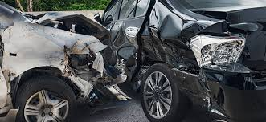
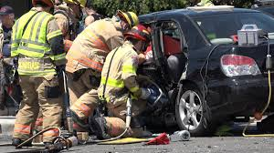
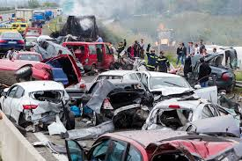
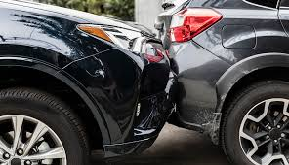
Accident Severity Report

Slide 2
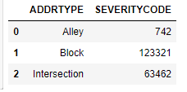
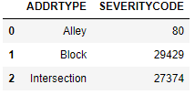
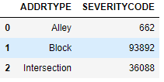
Accidents and accident areas
Total Collisions
In the block area, maximum collisions occurred 66% of total collisions.
However, intersections are more prone to injury collisions, 43% where as 24% of block area collisions are injury collisions.
Total Injury Collisions
Total Property Damage Collisions

Slide 3
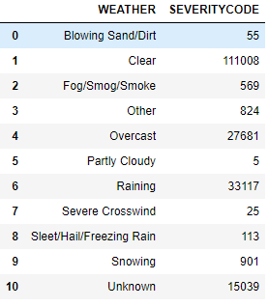
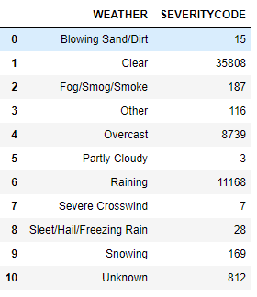
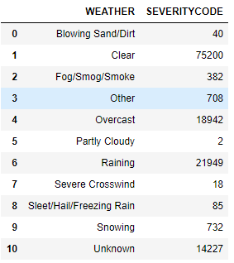
Accidents and Weather Conditions
Total Collisions
59% of total collisions occurred in clear weather conditions.
In case of clear, overcast and raining weather conditions, 32%, 32% and 34% respectively collisions were injury collisions.
Total Injury Collisions
Total Property Damage Collisions

Slide 4
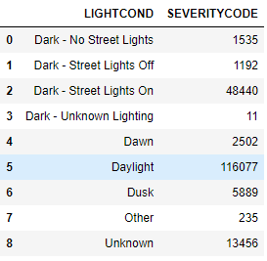
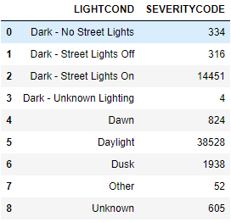
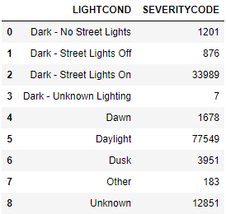
Accidents and Light Conditions
Total Collisions
61% of total collisions occurred in day light condition.
Approximately, 30% to 36% of total collisions are injury collisions, however, dark-no street lights or street lights off are conditions where property damage occurred more in comparison to other light conditions.
Total Injury Collisions
Total Property Damage Collisions

Slide 5
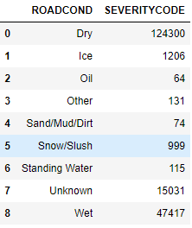
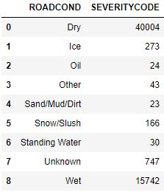
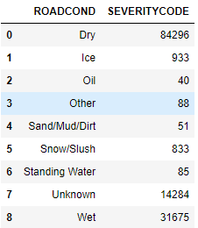
Accidents and Road Conditions
Total Collisions
66% of total collisions occurred in dry road condition.
In case of dry and wet road conditions, ~32% of collisions are injury collisions, however oil road condition is the most dangerous condition, where 38% of total collisions are injury collisions.
Total Injury Collisions
Total Property Damage Collisions

